Slide 2
learn what is Hadoop,
understand the Hadoop Core components,
learn Hadoop Daemons,
learn How Hdfs Works.

Slide 3
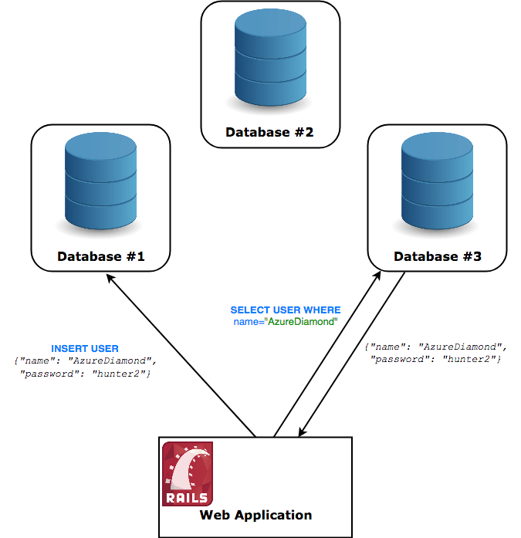
Introduction
Distributed Manner

Slide 4
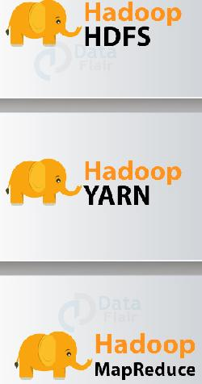
Introduction
Hadoop provides the world’s most reliable storage layer
Storage
Layer

Slide 5
Introduction
Hadoop provides the world’s most reliable storage layer
Application
Layer

Slide 6
Introduction
Hadoop provides the world’s most reliable storage layer
Resource
Management
Layer

Slide 7
What is Hadoop Distribute File System(HDFS)
Maintain huge volumes of data
Break down the data into smaller chunks
Distributed file systems.
Hadoop Distributed File System (HDFS) is the storage component

Slide 8
What is Hadoop Distribute File System(HDFS)
Maintain huge volumes of data
Break down the data into smaller chunks
Distributed file systems.
Hadoop Distributed File System (HDFS) is the storage component

Slide 9
What is Hadoop Distribute File System(HDFS)
Maintain huge volumes of data
Break down the data into smaller chunks
Distributed file systems.
Hadoop Distributed File System (HDFS) is the storage component

Slide 10
What is Hadoop Distribute File System(HDFS)
Maintain huge volumes of data
Break down the data into smaller chunks
Distributed file systems.
Hadoop Distributed File System (HDFS) is the storage component

Slide 11
What is Hadoop Distribute File System(HDFS)
It has a few properties that define its existence:-
Huge volumes
Data access
Cost-effective

Slide 12
What is Hadoop Distribute File System(HDFS)
It has a few properties that define its existence:-
Huge volumes
Data access
Cost-effective

Slide 13
What is Hadoop Distribute File System(HDFS)
It has a few properties that define its existence:-
Huge volumes
Data access
Cost-effective

Slide 14
Hadoop Components and Domains
Hadoop consists of three layers (core components) and they are:-
HDFS – Hadoop Distributed File System
MapReduce
Yarn – Yet Another Resource Manager

Slide 15
Hadoop Components
The storage of Hadoop.
Stores the data in a distributed manner.
The file gets divided into a number of blocks.

Slide 16
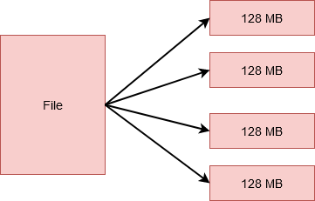
Hadoop Components
Example

Slide 17
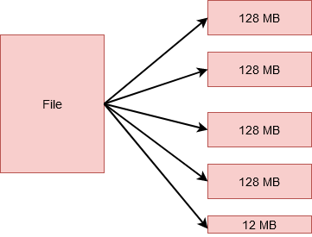
Hadoop Components
Example

Slide 18

Hadoop Components
Why such a huge amount in a single block?
Why not multiple blocks of 10KB each?

Slide 19
Hadoop Components
There are several perks to storing data in blocks rather than saving the complete file.
The file itself would be too large to store on any single disk alone.
Proper spread of the workload
Prevent the choke of a single machine

Slide 20
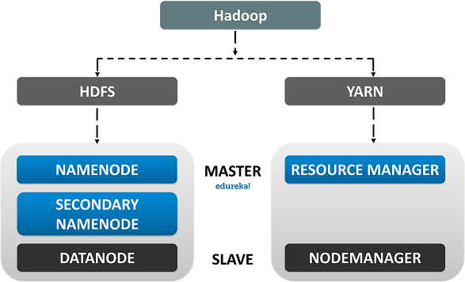
Hadoop Components
The HDFS comprises the following components

Slide 21
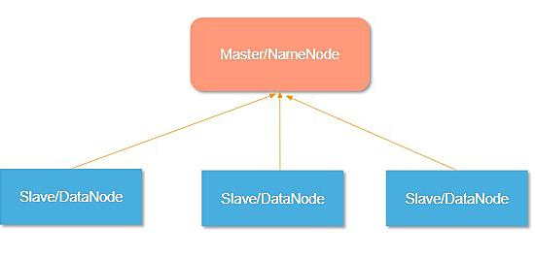
Hadoop Components
Namenode in HDFS

Slide 22
Hadoop Components
Namenode is the master node that runs on a separate node in the cluster.
Manages the filesystem namespace
Stores information
aware of the locations of all the blocks

Slide 23
Hadoop Components
Namenode is the master node that runs on a separate node in the cluster.
Manages the filesystem namespace
Stores information
aware of the locations of all the blocks

Slide 24
Hadoop Components
Namenode is the master node that runs on a separate node in the cluster.
Manages the filesystem namespace
Stores information
aware of the locations of all the blocks

Slide 25
Hadoop Components
Information is maintained persistently over the local disk in the form of two files:
Fsimage
Edit Log.

Slide 26
Hadoop Components
Data node in HDFS
Worker nodes
Inexpensive commodity hardware
Responsible for storing, retrieving, replicating, deletion, etc.
Send heartbeats to the Namenode
Sends a list of blocks

Slide 27
Hadoop Components
Data node in HDFS
Worker nodes
Inexpensive commodity hardware
Responsible for storing, retrieving, replicating, deletion, etc.
Send heartbeats to the Namenode
Sends a list of blocks

Slide 28
Hadoop Components
Data node in HDFS
Worker nodes
Inexpensive commodity hardware
Responsible for storing, retrieving, replicating, deletion, etc.
Send heartbeats to the Namenode
Sends a list of blocks

Slide 29
Hadoop Components
Data node in HDFS
Worker nodes
Inexpensive commodity hardware
Responsible for storing, retrieving, replicating, deletion, etc.
Send heartbeats to the Namenode
Sends a list of blocks

Slide 30
Hadoop Components
Data node in HDFS
Worker nodes
Inexpensive commodity hardware
Responsible for storing, retrieving, replicating, deletion, etc.
Send heartbeats to the Namenode
Sends a list of blocks

Slide 31
Hadoop Components
Secondary Namenode in HDFS
Copy the Fsimage from disk to memory
Copy the latest copy of Edit Log to Fsimage
If we restart the node after a long time, then the Edit log could have grown in size.
Lot of time to apply the transactions from the Edit log.

Slide 32
Hadoop Components
Secondary Namenode in HDFS
Copy the Fsimage from disk to memory
Copy the latest copy of Edit Log to Fsimage
If we restart the node after a long time, then the Edit log could have grown in size.
Lot of time to apply the transactions from the Edit log.

Slide 33
Hadoop Components
Secondary Namenode in HDFS
Copy the Fsimage from disk to memory
Copy the latest copy of Edit Log to Fsimage
If we restart the node after a long time, then the Edit log could have grown in size.
Lot of time to apply the transactions from the Edit log.

Slide 34
Hadoop Components
Secondary Namenode in HDFS
Copy the Fsimage from disk to memory
Copy the latest copy of Edit Log to Fsimage
If we restart the node after a long time, then the Edit log could have grown in size.
Lot of time to apply the transactions from the Edit log.

Slide 35
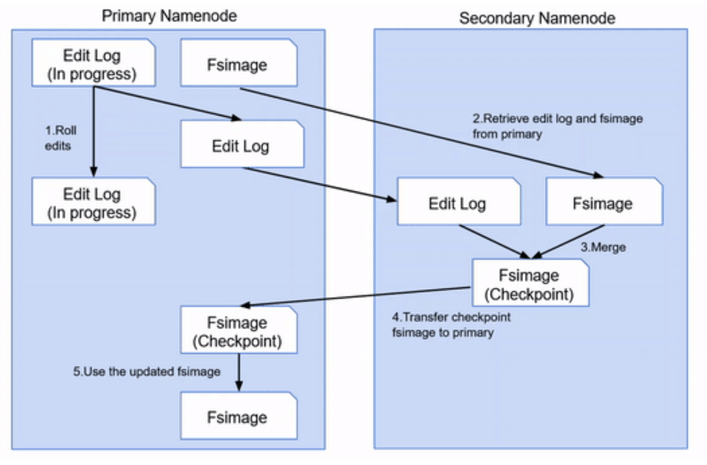
Hadoop Components

Slide 36
Hadoop Components

Slide 37
Hadoop Components

Slide 38
Hadoop Components

Slide 39
Hadoop Components
Secondary Namenode in HDFS
checkpointing procedure is computationally very expensive
Secondary namenode runs on a separate node on the cluster.
Secondary Namenode does not act as a Namenode.
Keeping a copy of the latest Fsimage.

Slide 40
Hadoop Components
Secondary Namenode in HDFS
checkpointing procedure is computationally very expensive
Secondary namenode runs on a separate node on the cluster.
Secondary Namenode does not act as a Namenode.
Keeping a copy of the latest Fsimage.

Slide 41
Hadoop Components
Secondary Namenode in HDFS
checkpointing procedure is computationally very expensive
Secondary namenode runs on a separate node on the cluster.
Secondary Namenode does not act as a Namenode.
Keeping a copy of the latest Fsimage.

Slide 42
Hadoop Components
Secondary Namenode in HDFS
checkpointing procedure is computationally very expensive
Secondary namenode runs on a separate node on the cluster.
Secondary Namenode does not act as a Namenode.
Keeping a copy of the latest Fsimage.

Slide 43
Hadoop Components
Mapreduce
This is the processing engine of Hadoop.
MapReduce works on the principle of distributed processing.
It divides the task submitted by the user into a number of independent subtasks.

Slide 44
Hadoop Components
Mapreduce
This is the processing engine of Hadoop.
MapReduce works on the principle of distributed processing.
It divides the task submitted by the user into a number of independent subtasks.

Slide 45
Hadoop Components
Mapreduce
This is the processing engine of Hadoop.
MapReduce works on the principle of distributed processing.
It divides the task submitted by the user into a number of independent subtasks.

Slide 46
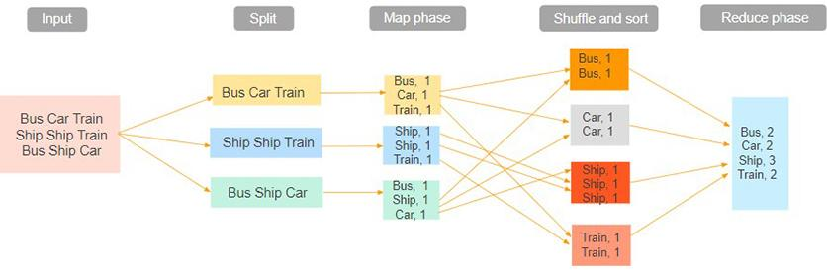
Hadoop Components

Slide 47
Hadoop YARN
Hadoop YARN stands for Yet Another Resource Negotiator. It is the resource management unit of Hadoop and is available as a component of Hadoop version 2.
Hadoop YARN acts like an OS to Hadoop. It is a file system that is built on top of HDFS.
It is responsible for managing cluster resources to make sure you don't overload one machine.
It performs job scheduling to make sure that the jobs are scheduled in the right place

Slide 48
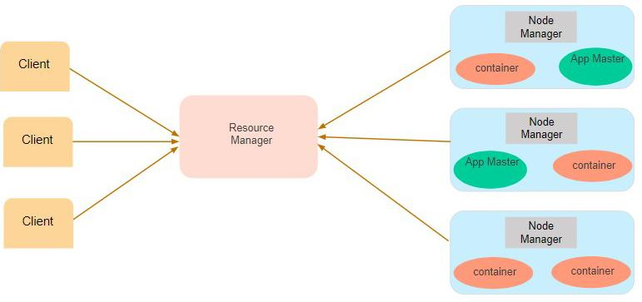
Hadoop YARN

Slide 49
Hadoop Daemons
The Hadoop Daemons are:-
Namenode
Datanode
Resource Manager
Node Manager

Slide 50
How HDFS works?
The Hadoop MapReduce works as follows:
Divides the job into tasks of two types
map tasks.
and reduce tasks

Slide 51
How HDFS works?
YARN scheduled these tasks
MapReduce job is divided into fixed-size pieces
map tasks run on the DataNodes where the input data resides.
output of the map task is intermediate output
intermediate outputs of the map tasks are shuffled

Slide 52
How HDFS works?
the sorted intermediate output of mapper is passed to the node where the reducer task is running.
reduce function summarizes the output
For multiple reduce functions, the user specifies the number of reducers

Slide 53
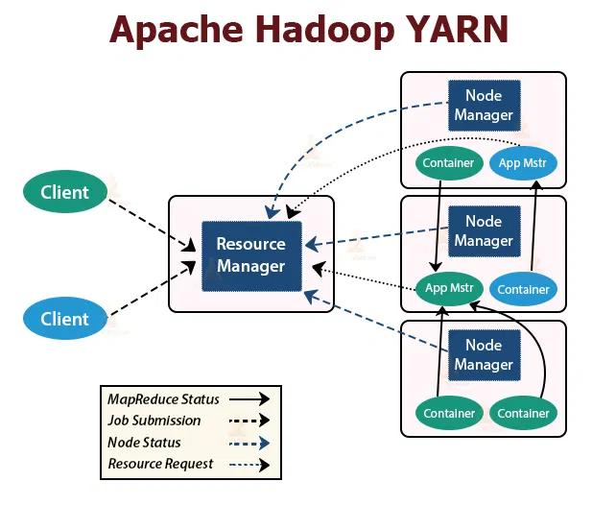
How HDFS works?

Slide 54
How HDFS works?
There are two YARN daemons running in the Hadoop cluster for serving YARN core services. They are:
Resource Manager
Node Manager
Application Master

Slide 55
Summarize how Hadoop works internally

